Slide 1
EE746 Course Projects
Shashwat Shukla
March 6, 2020

Slide 2
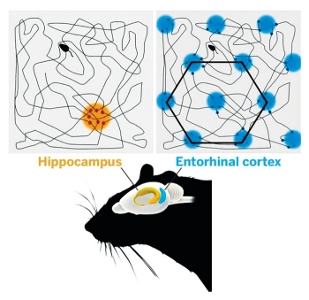
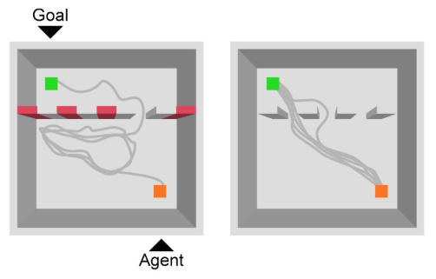
Robot path planning using SNNs
How does the brain's GPS work?
We want our C. elegans bot to estimate and remember where it is on the grid.
Goal: Use an SNN to model grid cells found in the brain, use it to perform spatial navigation
Stage 1:
Implement STDP in an SNN to observe emergence of grid cells
Stage 2:
Use output from learned SNN to perform path planning
https://www.ncbi.nlm.nih.gov/pubmed/25033187
https://journals.plos.org/ploscompbiol/article?id=10.1371/journal.pcbi.1000291
https://www.its.caltech.edu/~bi250c/papers/Banino-2018.pdf

Slide 3
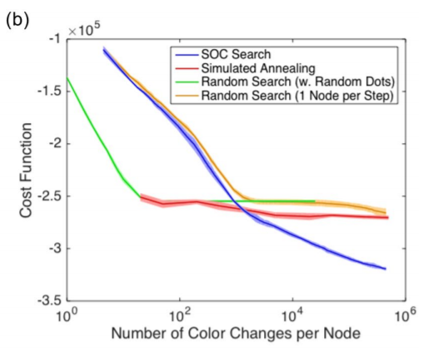
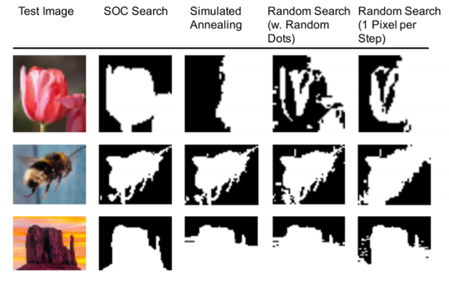
SOC-search with LSMs
Self-Organized Criticality (SOC) has been observed in the brain
Non-neural SOC systems have been used to solve optmisation tasks: SOC-search for graph coloring, image segmentation etc
Goal: Drive an LSM to criticality and then use it to power SOC-search
Stage 1:
Implement SOC-search without neurons
Implement a vanilla LSM
Stage 2:
Use homeostatic learning to drive LSM to criticality
Use output from critical LSM to drive SOC-search
https://www.nature.com/articles/s41598-018-20275-7
https://d-nb.info/993515274/34

Slide 4
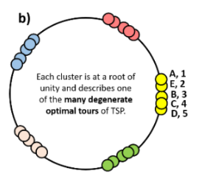
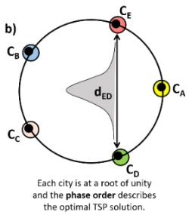
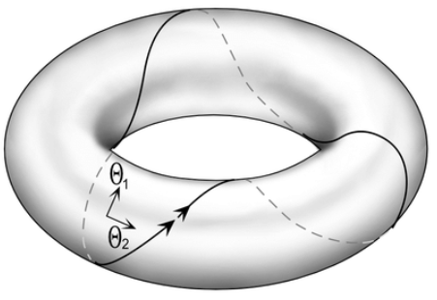
2D Oscillators for ONNs to solve CSPs
The Travelling Salesman Problem (TSP) is one of many Constraint Satisfaction Problems (CSPs), can be mapped onto Oscillatory Neural Networks (ONNs).
Our group: reduced number of neurons from N² to N.
Dynamics still restricted to a circle: hard for particles to cross over.
Goal: Replace 1D oscillators with 2D oscillators, motion now on a torus.
Stage 1:
Derive equations for oscillator dynamics
Stage 2:
Code up and test new ONN for TSP and other CSPs
Landge et al, Oscillator Network based Efficient Cost Function for Traveling Salesman Problem, Submitted to IJCNN 2020

Slide 5
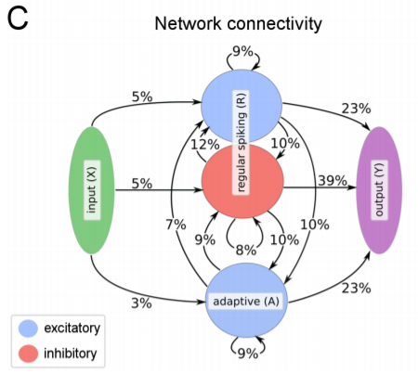
Meta-learning in Recurrent SNNs
Can a network learn to learn?
Goal: Use Meta-RL to train a recurrent SNN with adaptive neurons on multiple tasks to observe the emergence of working memory
Stage 1:
Code up a recurrent SNN with adaptive neurons
Stage 2:
Train the network concurrently on two disparate tasks such as navigation and digit recognition
https://arxiv.org/abs/1803.09574

Slide 6
Neural Architecture Search
ResNets and CNNs show that network topology may be much more important than precise weights
Motivates learning network architecture while using random weights (NAS)
Goal: Design and implement NAS algorithms for SNNs
Stage 1:
Code up SNN for supervised MNIST classification
Design the NAS approach
Stage 2:
Implement the NAS algorithm
Compare performance with ANNs and LSMs
https://weightagnostic.github.io/ ; https://arxiv.org/pdf/1711.05136.pdf
https://arxiv.org/pdf/1904.01569.pdf ; https://arxiv.org/pdf/1906.00586.pdf

